Slide 1
Application Memory Management
Presented by
Tech King

Slide 2
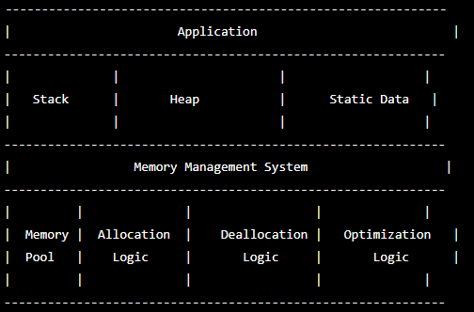
Introduction :
Application memory management is the process of managing the usage of
Memory by a software application running on a mobile system.
Application Memory Management Diagram :

Slide 3
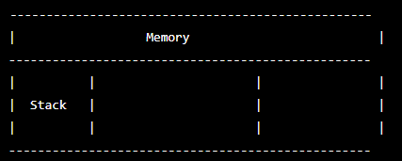
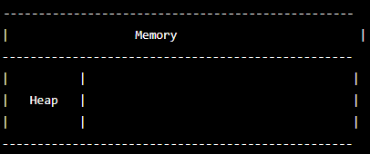
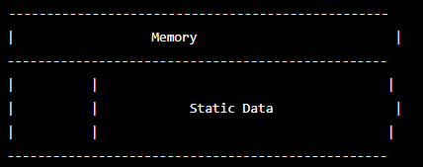
Stack : This is a region of memory that is used to store variables, function call stacks, and other data related to the execution of the application.
Heap : This is a region of memory that is dynamically allocated by the application as needed to store data structures such as arrays, lists, and objects.
Static Data : This is a region of memory that is used to store global variables and other data that is declared outside of functions.

Slide 4
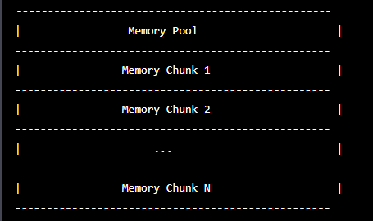
Memory pools : are a way of managing memory allocation by pre-allocating a block of memory and dividing it into smaller fixed-size chunks, called memory chunks

Slide 5
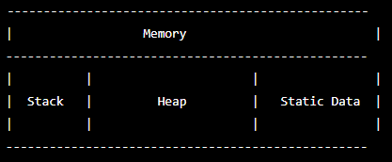
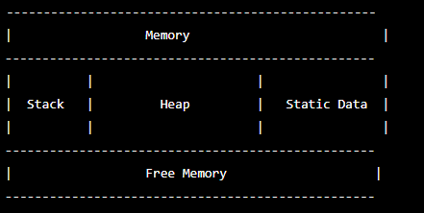
Allocation logic : is the code that determines how memory is allocated by the application. It determines how much memory is needed, where in memory it will be stored, and how it will be organized.
Deallocation logic : is the code that is responsible for releasing memory that is no longer needed by the application

Slide 6
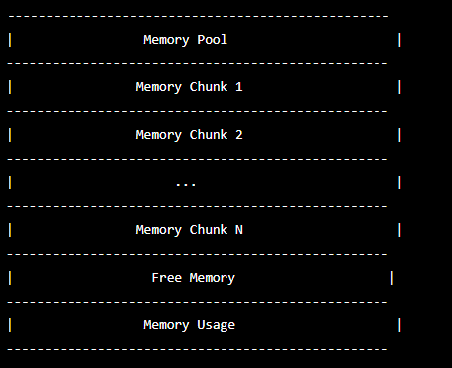
Optimization Logic :
Optimization logic refers to the techniques used to optimize memory usage and performance. As you can see, the optimization logic is responsible for managing memory usage and preventing fragmentation. This can be done by using techniques like memory reuse, which involves reusing memory that was previously allocated rather than allocating new memory; garbage collection, which automatically frees memory that is no longer needed by the application; and memory fragmentation prevention, which involves managing memory allocation to prevent fragmentation and ensure that memory is used efficiently.

Slide 7
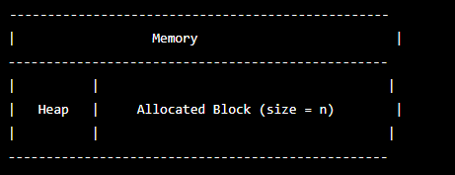
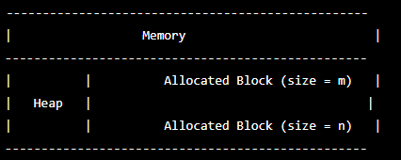
Dynamic Memory Allocation :
Allocation and Deallocation :
Fragmentation :

Slide 8
Memory Fragmentation Prevention s:
Memory Pools: In memory pools, a fixed number of memory blocks of a particular size are pre-allocated in advance, and the application uses these blocks as needed. This helps to prevent fragmentation by ensuring that memory blocks of the same size are contiguous and reduces the frequency of allocating and deallocating memory.
Dynamic Resizing: Instead of allocating fixed-size blocks of memory, an application can allocate memory dynamically and resize it as needed. This helps to prevent fragmentation by allowing the application to adjust the size of allocated memory to match the actual needs of the application.
Memory Compaction: Memory compaction is a technique that involves moving memory blocks around to fill in gaps and make the memory contiguous. This can be done by periodically scanning the heap for unused memory and moving the used memory to a new location. Memory compaction can be resource-intensive and can impact performance, but it can significantly reduce fragmentation.
Smart Pointers: Smart pointers are objects that behave like pointers but also have additional functionality. Smart pointers can automatically manage the allocation and deallocation of memory and can help prevent memory leaks and fragmentation.
Garbage Collection: Garbage collection is a technique used by some programming languages to automatically free memory that is no longer needed by the application.

Slide 9
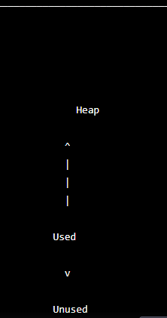
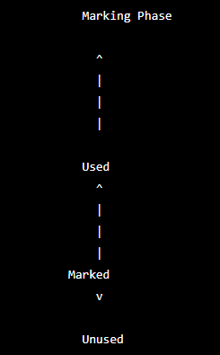
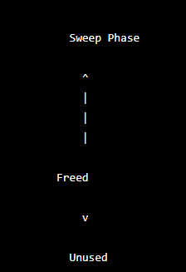
Garbage collection : can help prevent fragmentation by automatically deallocating memory that is no longer being used, which reduces the frequency of allocating and deallocating memory.

Slide 10
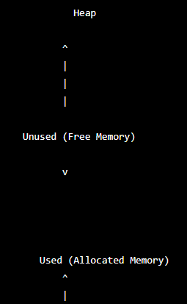
Memory Leak :
A memory leak occurs when an application allocates memory but fails to release it, causing memory usage to grow over time and potentially leading to system instability or crashes.

Slide 11
Memory Profiling Tools :
Memory allocation tracking: Memory profiling tools can track every memory allocation and deallocation performed by an application, including the size and type of memory being allocated. Eg. Valgrid
Memory usage analysis: Memory profiling tools can provide detailed information about how memory is being used by different parts of an application, allowing developers to identify areas where memory usage could be optimized. Eg. Valgrid
Memory leak detection: Memory profiling tools can detect memory leaks by identifying memory that has been allocated but not properly released.
Performance analysis: Memory profiling tools can analyze the performance impact of memory usage on an application, including how memory usage affects the application's speed and responsiveness. Eg. Valgrid
Visualizations: Many memory profiling tools provide visualizations that make it easy to understand how memory is being used by an application, including charts and graphs that show memory usage over time. Eg. Tableau

Slide 12
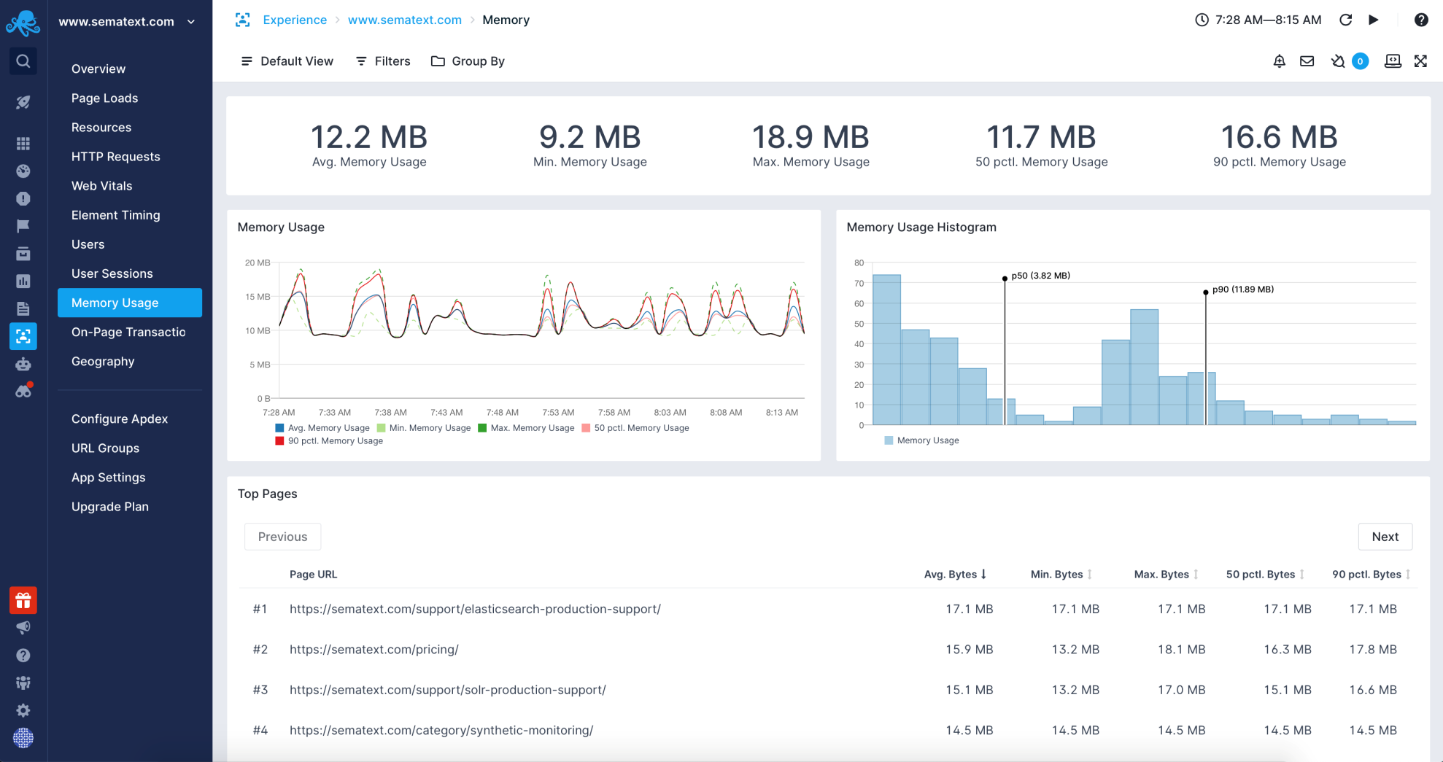
Example of Memory Profiling Tools :

Slide 13
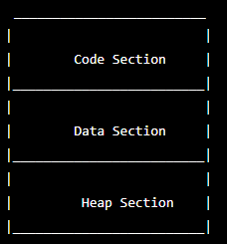
Memory Management in C Programming :

Slide 14
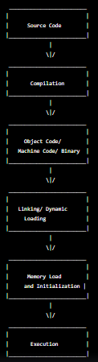
Program Execution :
Source Code: The program is written in a high-level programming language and stored in a file.
Compilation: The compiler reads the source code and generates object code in a file.
Linking/Dynamic Loading: If the program uses external libraries or modules, the linker reads the object code and links it with the necessary libraries to create a complete executable program. Alternatively, during dynamic loading, the operating system loads the libraries at runtime when they are needed.
Memory Load and Initialization: The executable program is loaded into memory, and its code and data segments are initialized.
Execution: The program's instructions are executed by the CPU, and it interacts with the computer's memory, input/output devices, and other resources as needed.

Slide 15
THANK YOU.
Any Question?

